Slide 1
Unit 4

Slide 2

Advance organizer
Learning objectives:
Understand 7.1 Exploring Exponential Models
Prior knowledge:
Understand 4.8 Complex Numbers
Successful criteria:
Controlled Practice: Complete the Exit Card
Freer Practice: Complete questions to your interest
Learning activities:
1. Preview and Vocabulary Check (10 minutes):
Quickly scan through the text and noting any unfamiliar terms.
2. Comprehend the Presentation (45 minutes):
3. Exit Card Completion (25 minutes):
4. Main Idea Summary and Reflection (5 minute):

Slide 3
Key terms:
1. Exponential function [指数函数]: A mathematical function in which the variable appears as an exponent, often written in the form f(x) = ab^x.
2. Exponential growth[指数增长]: A process of growth characterized by a constant proportional increase over equal increments of time.
3. Exponential decay[指数衰减]: A process of decay characterized by a constant proportional decrease over equal increments of time.
4. Asymptotes[渐近线]: Straight lines that a curve approaches but never quite reaches as the independent variable approaches infinity or negative infinity.
5. Growth factor[增长因子]: The factor by which a quantity increases in exponential growth.
6. Decay factor[衰减因子]: The factor by which a quantity decreases in exponential decay.

Slide 4
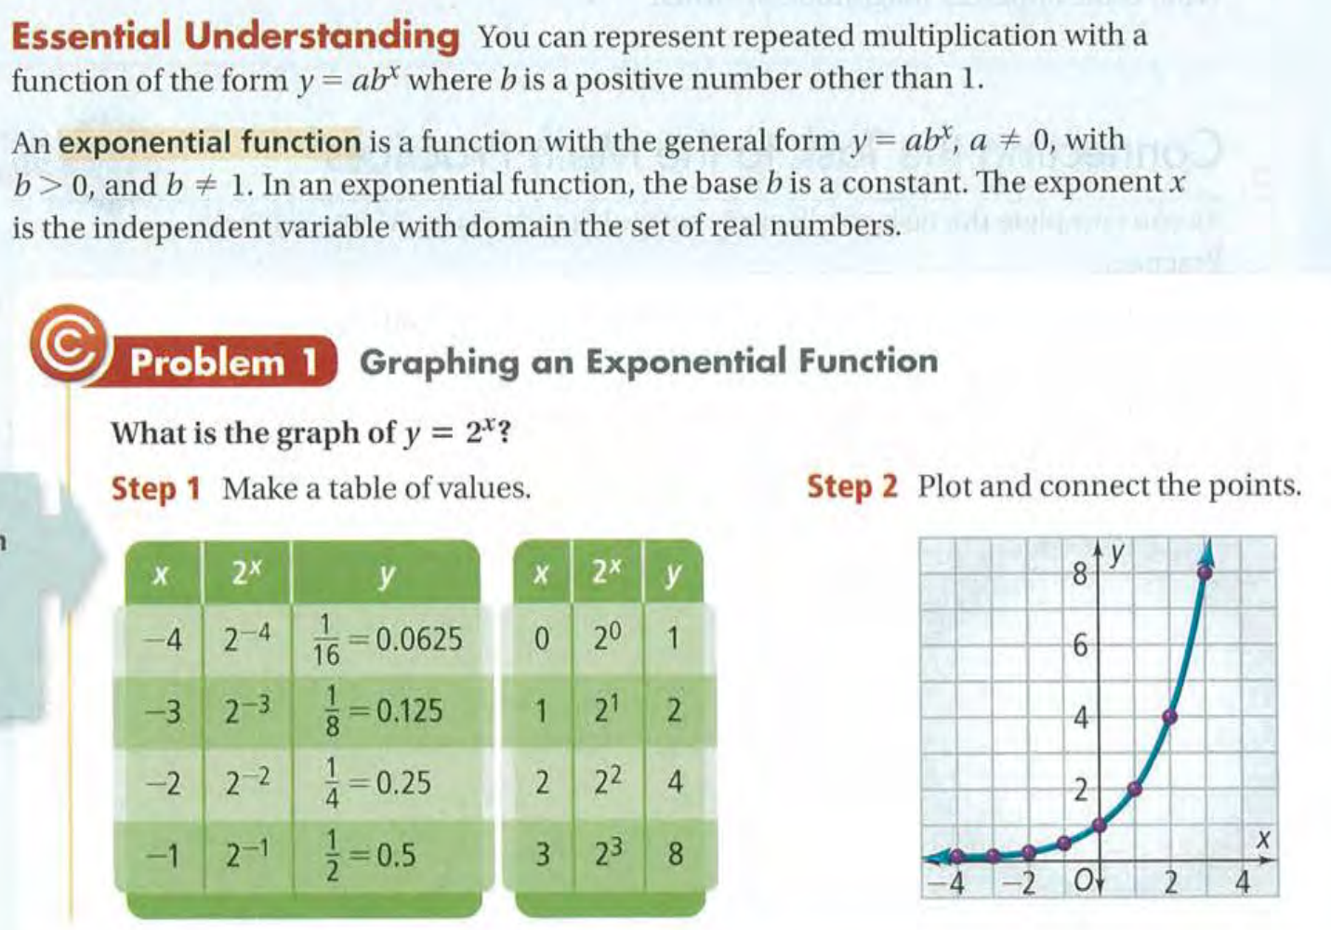

Slide 5
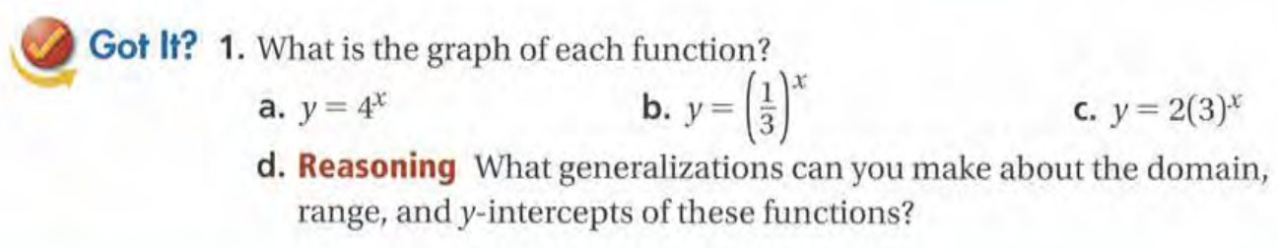

Slide 6
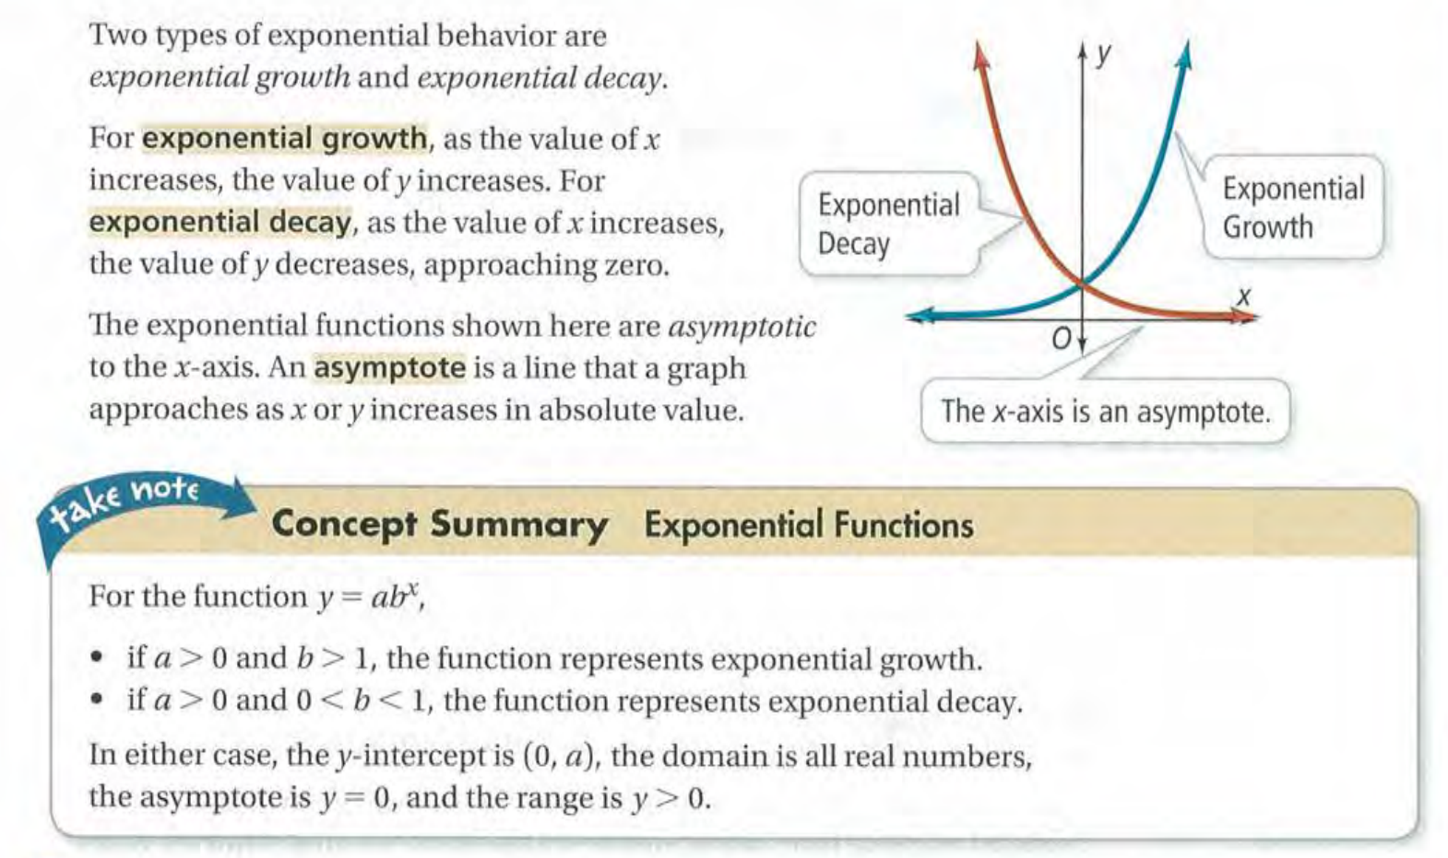

Slide 7
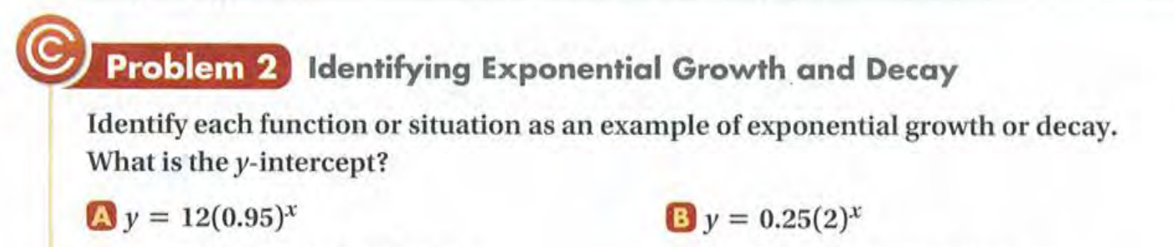

Slide 8
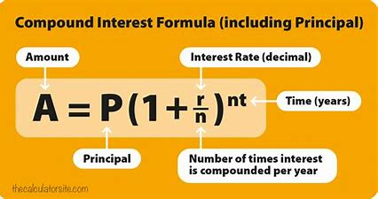
Compound Interest (复利)

Slide 9
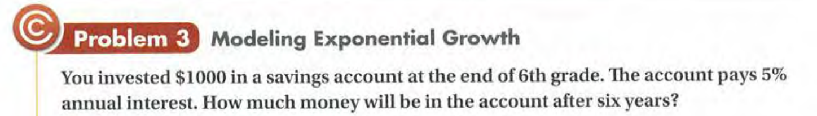

Slide 11
Exit Card:
Complete the ‘Exploring Exponential Models’ learning sheet!
Watch the Khan Academy video for EX#1

Slide 12
Advance organizer
Learning objectives:
Understand 7.2 Properties of Exponential Functions
Prior knowledge:
Understand 7.1 Exploring Exponential Models
Successful criteria:
Controlled Practice: Complete the Exit Card
Freer Practice: Complete questions to your interest
Learning activities:
1. Preview and Vocabulary Check (10 minutes):
Quickly scan through the text and noting any unfamiliar terms.
2. Comprehend the Presentation (45 minutes):
3. Exit Card Completion (25 minutes):
4. Main Idea Summary and Reflection (5 minute):

Slide 13
Key terms:
Natural base exponential function [自然底数指数函数] :The natural base exponential function is a mathematical function of the form f(x) = e^x, where e is Euler's number (approximately 2.71828). It represents continuous growth or decay at a rate proportional to the current value.
Continuously compounded interest[连续复利]: Continuously compounded interest refers to the method of calculating interest where the interest is added to the principal continuously, and the interest earned during each instant is immediately added to the principal for the next compounding period.

Slide 14
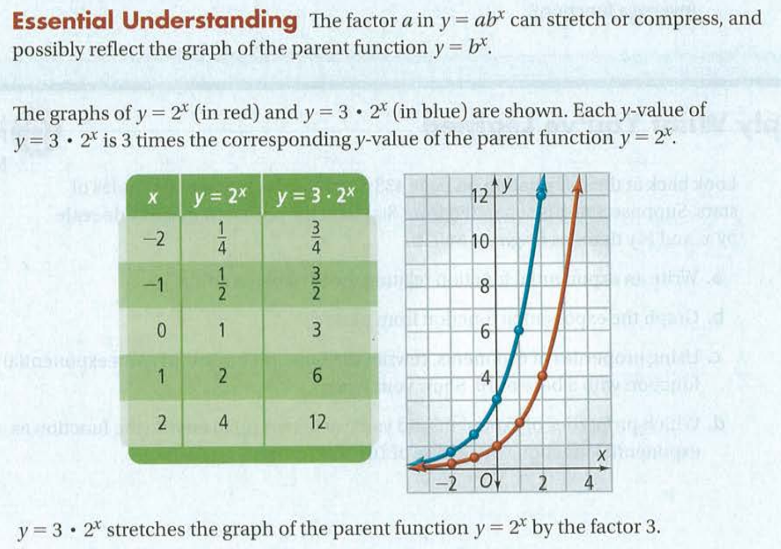

Slide 15
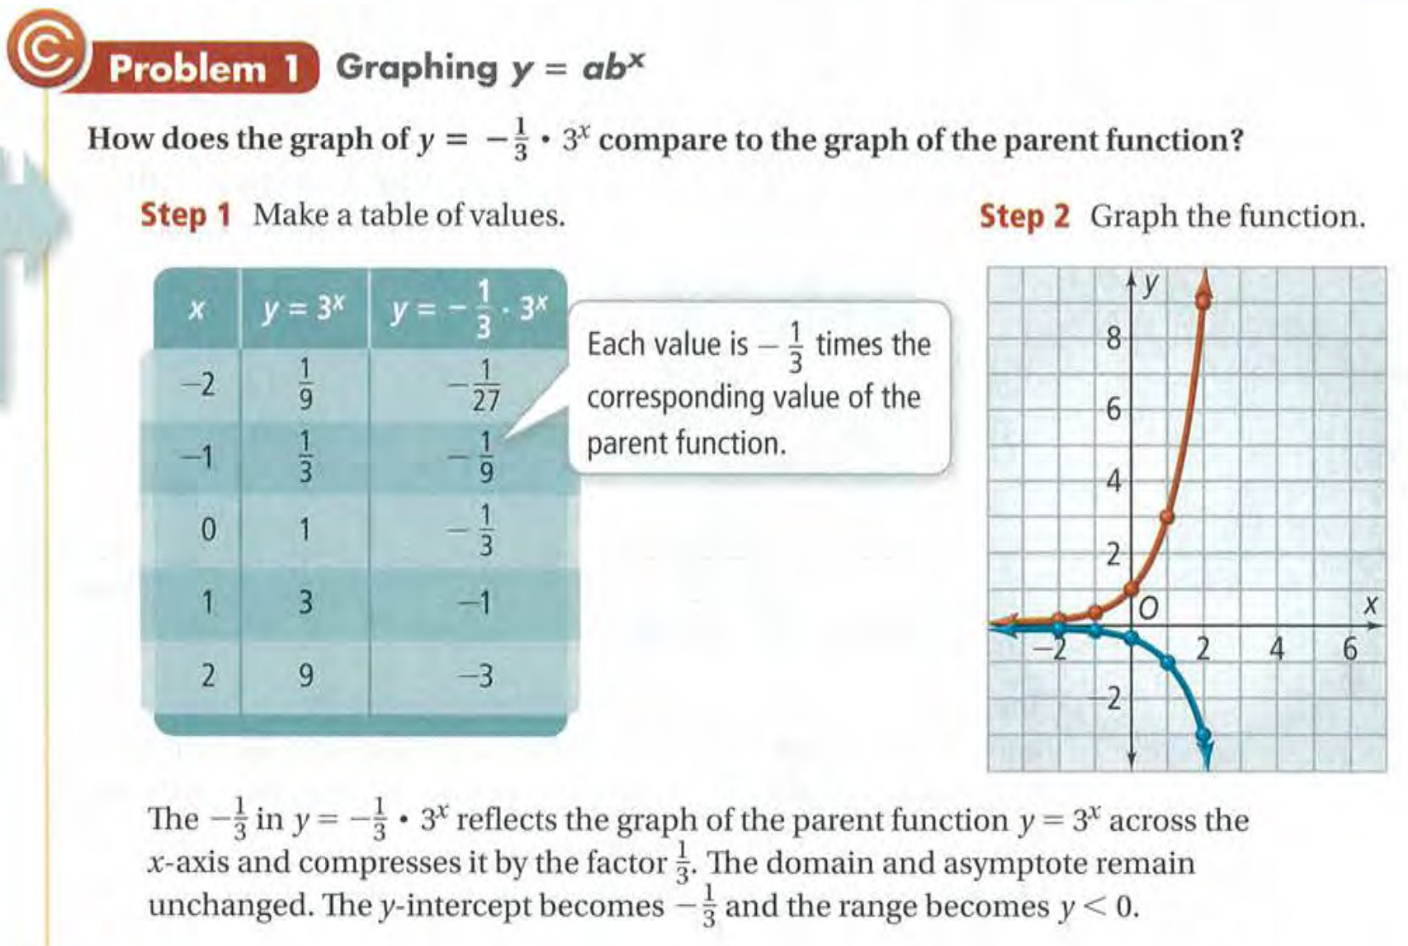

Slide 17
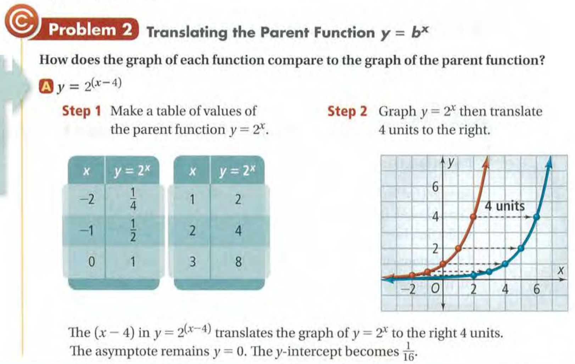

Slide 18
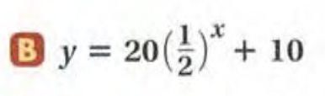

Slide 19
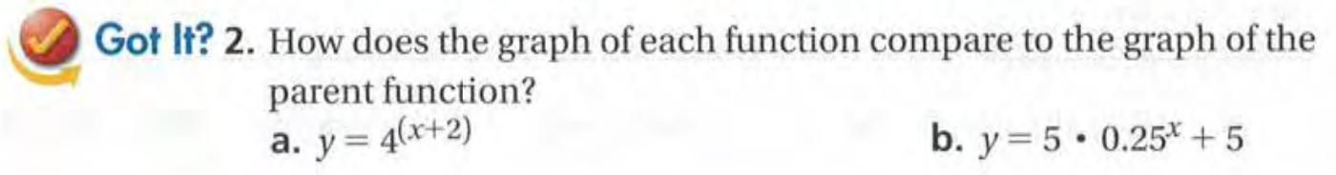

Slide 20
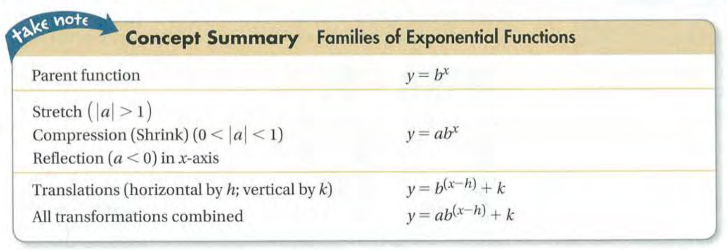

Slide 21
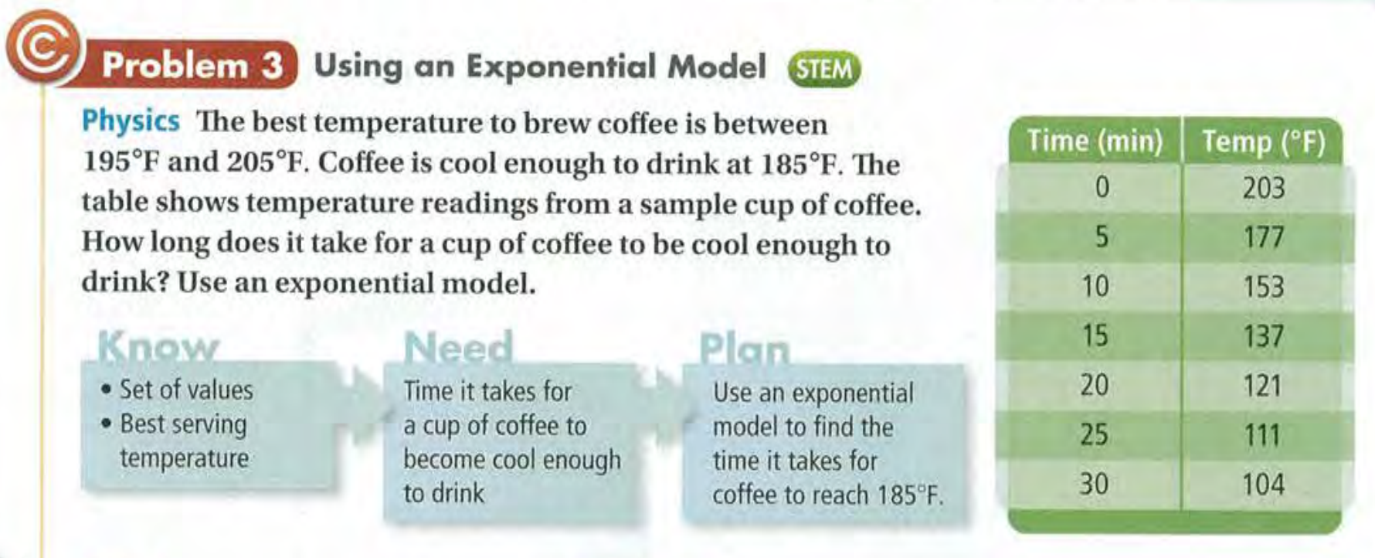

Slide 22
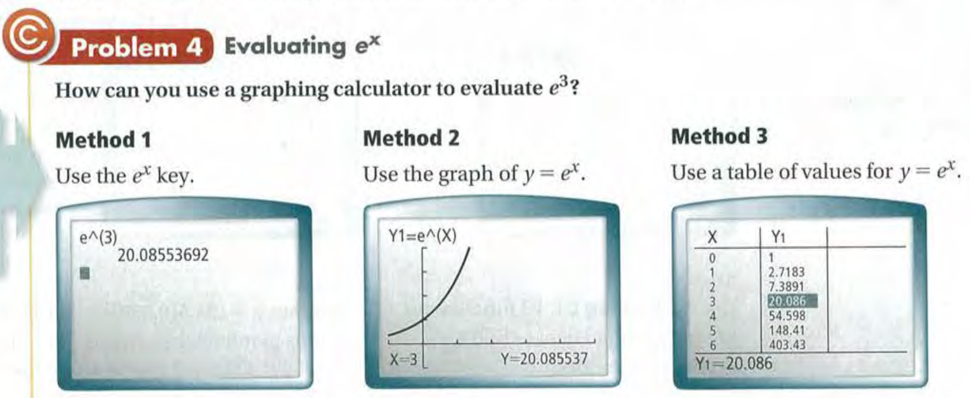

Slide 23
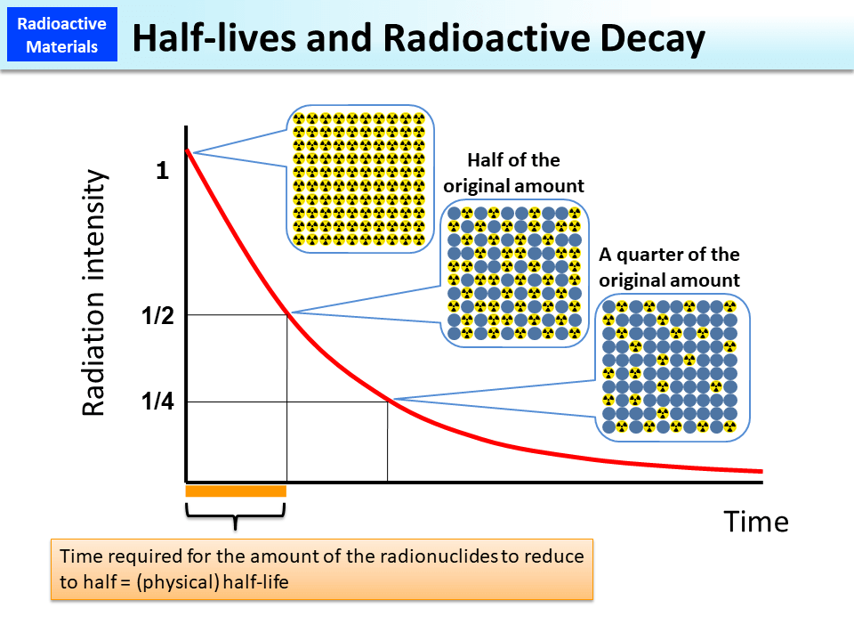

Slide 24
Continuously compound interest (连续复利)

Slide 25
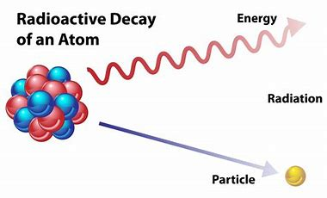
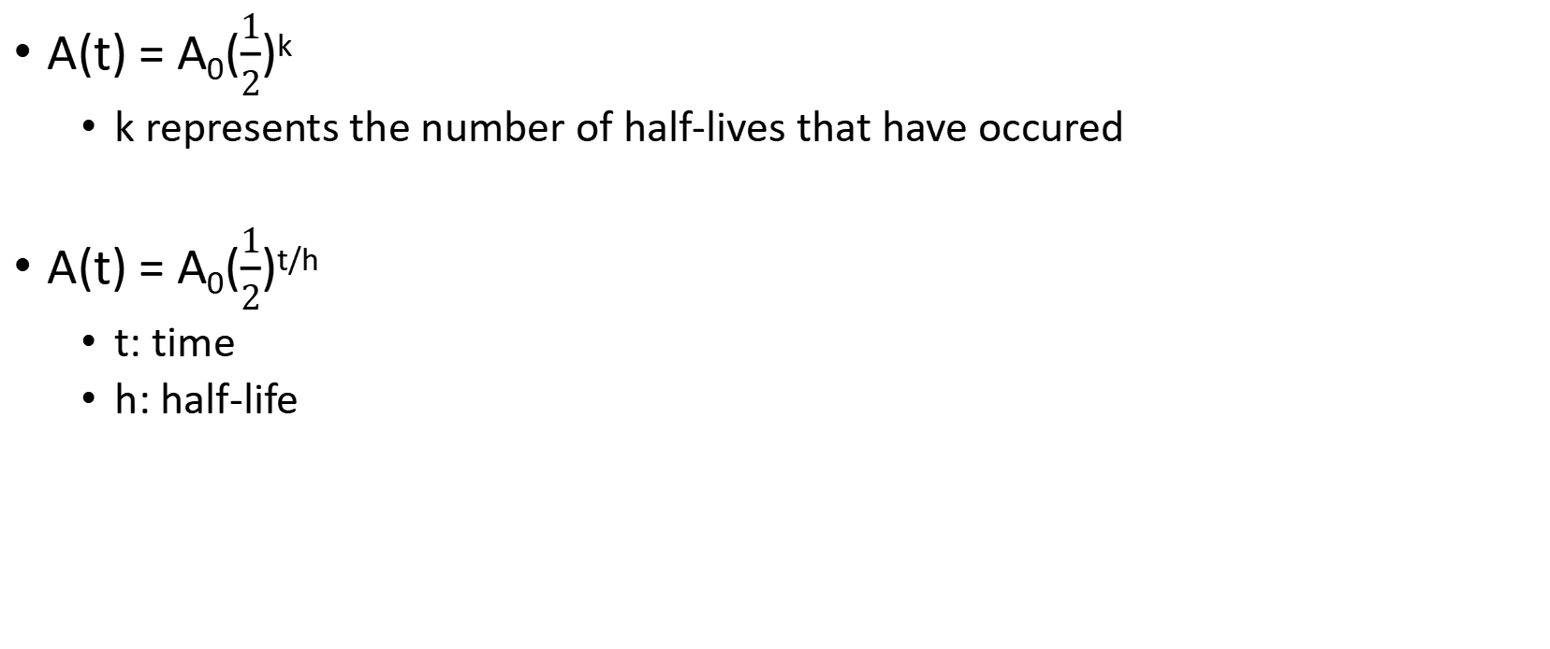
Half-life
A(t) = A₀($\frac{1}{2}$)^{k}
k represents the number of half-lives that have occured
A(t) = A₀($\frac{1}{2}$)^{t/h}
t: time
h: half-life

Slide 26
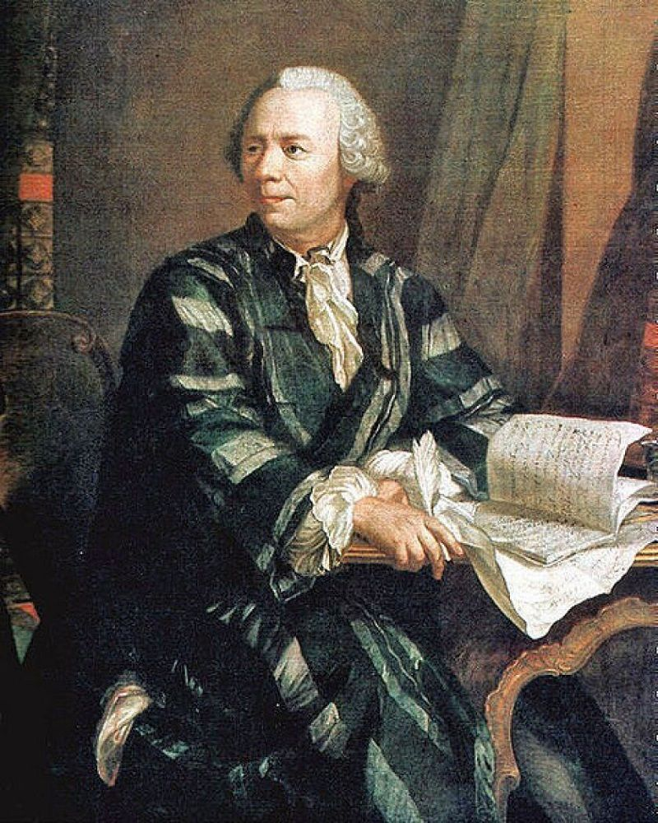
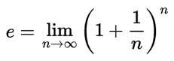
Euler’s constant

Slide 27
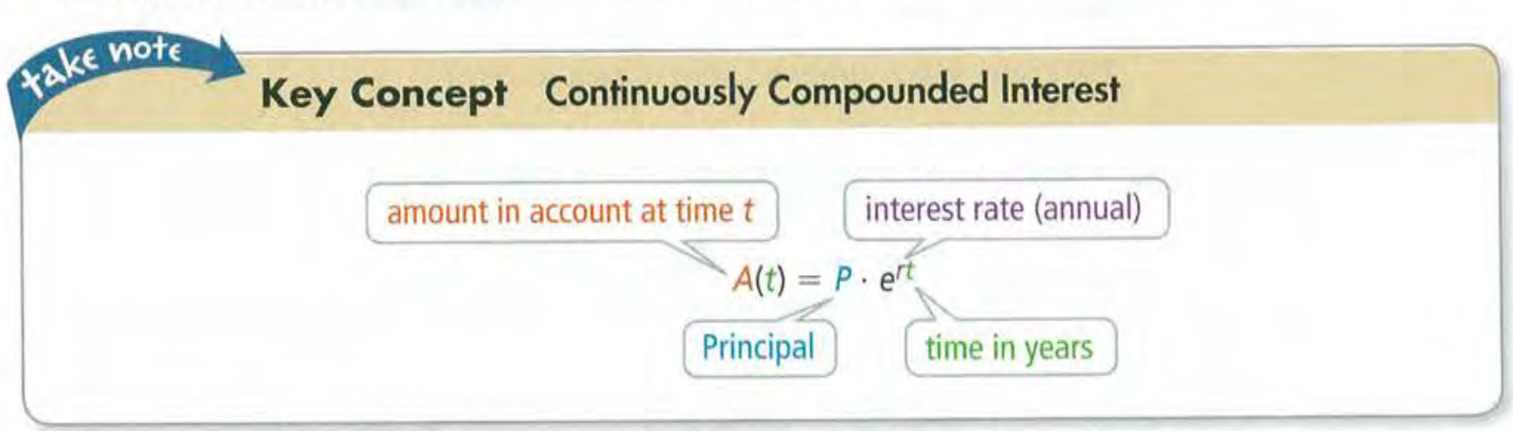

Slide 28
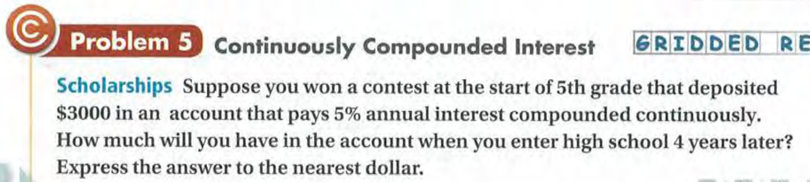

Slide 29
Exit Card:
Complete the “Properties of Exponential Functions” learning sheet!

Slide 30
Advance organizer
Learning objectives:
Understand 7.3 Logarithmic Functions as Inverses
Prior knowledge:
Understand 7.2 Properties of Exponential Functions
Successful criteria:
Controlled Practice: Complete the Exit Card
Freer Practice: Complete questions to your interest
Learning activities:
1. Preview and Vocabulary Check (10 minutes):
Quickly scan through the text and noting any unfamiliar terms.
2. Comprehend the Presentation (45 minutes):
3. Exit Card Completion (25 minutes):
4. Main Idea Summary and Reflection (5 minute):

Slide 31
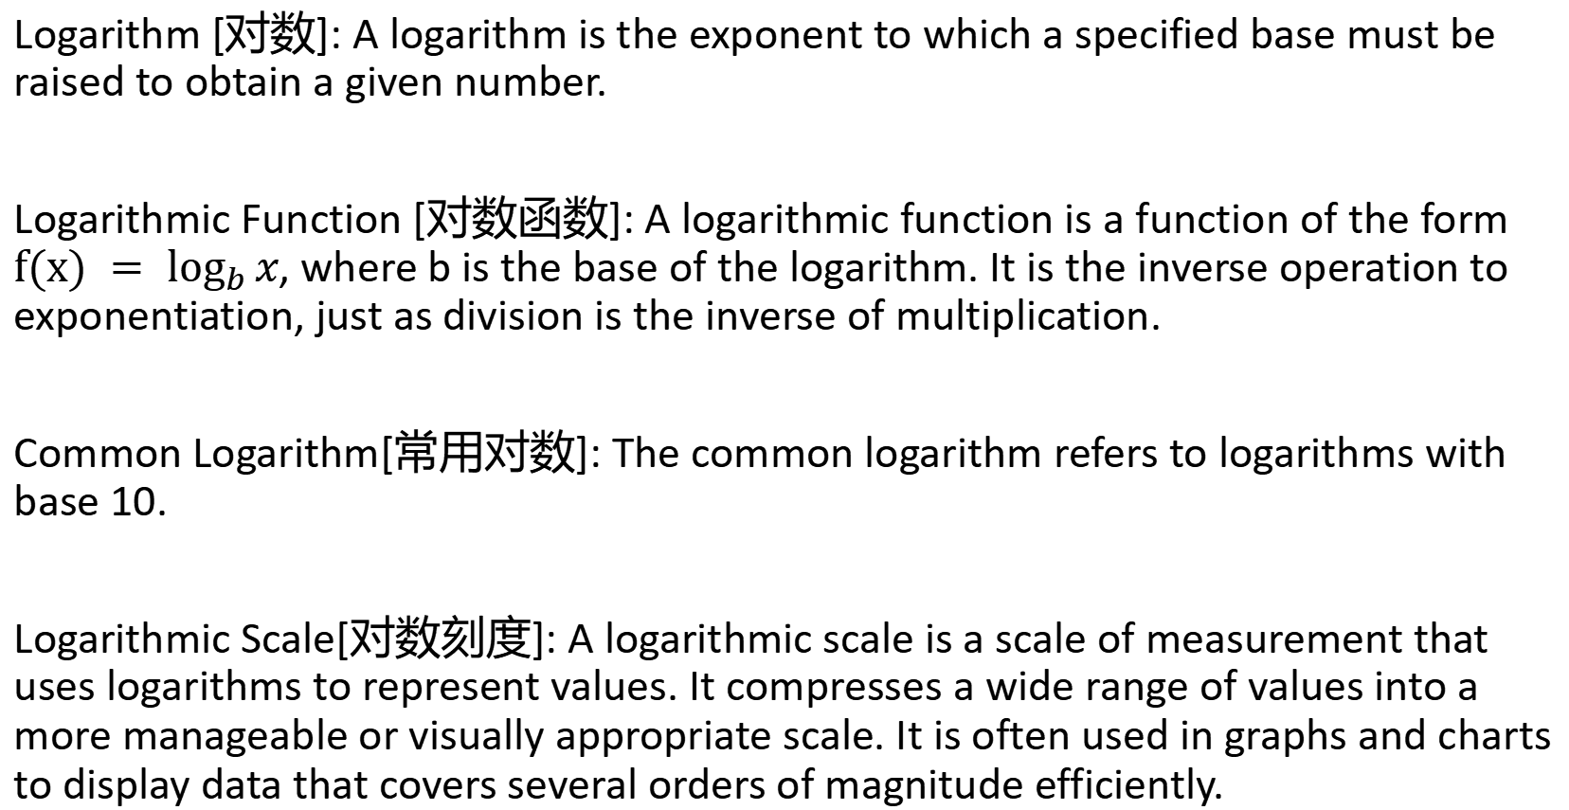
Key terms:
Logarithm [对数]: A logarithm is the exponent to which a specified base must be raised to obtain a given number.
Logarithmic Function [对数函数]: A logarithmic function is a function of the form $f(x) = \log_{b}{x}$, where b is the base of the logarithm. It is the inverse operation to exponentiation, just as division is the inverse of multiplication.
Common Logarithm[常用对数]: The common logarithm refers to logarithms with base 10.
Logarithmic Scale[对数刻度]: A logarithmic scale is a scale of measurement that uses logarithms to represent values. It compresses a wide range of values into a more manageable or visually appropriate scale. It is often used in graphs and charts to display data that covers several orders of magnitude efficiently.

Slide 32
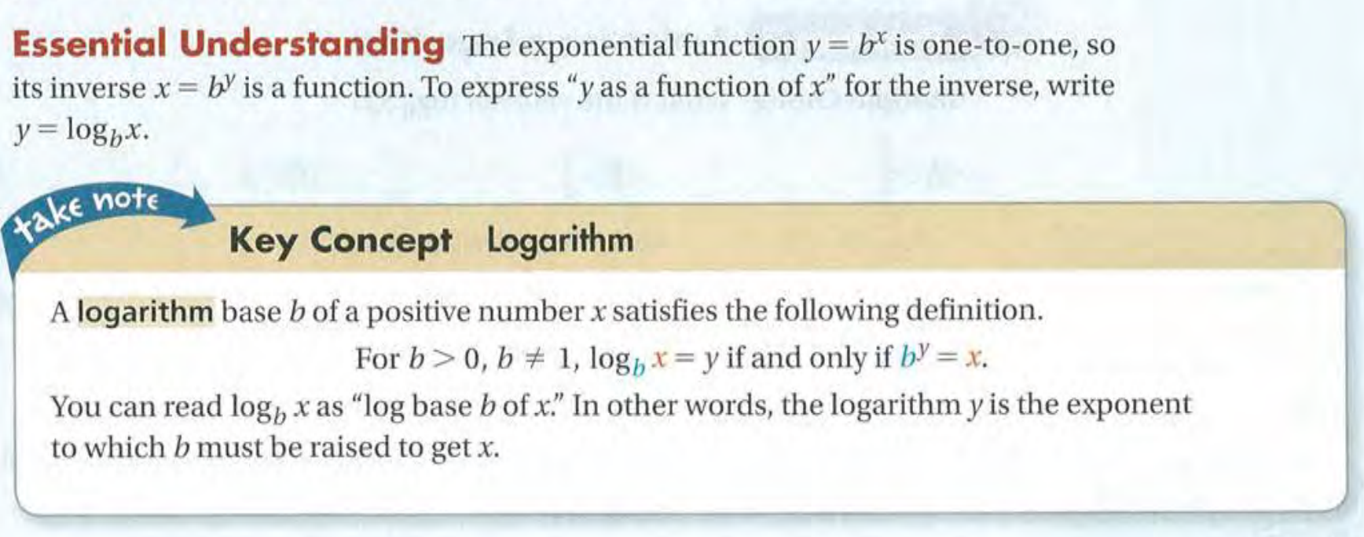

Slide 33
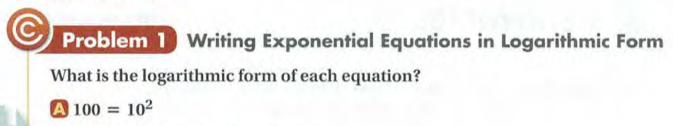
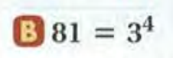

Slide 34
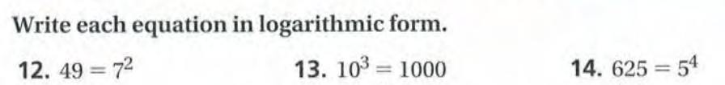

Slide 35
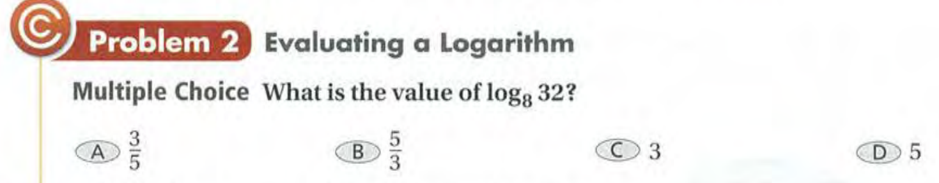

Slide 37
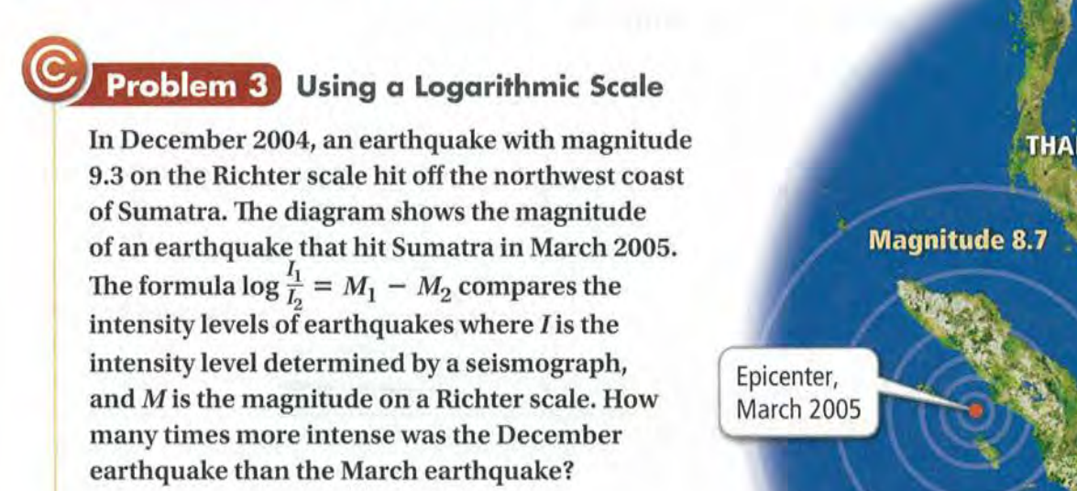

Slide 38
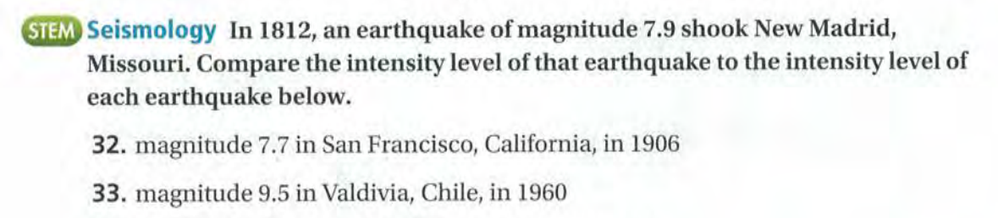

Slide 39
Exit Card - Part 1
Complete the following on your “Logrithmic Functions as Inverses” learning sheet!
Definition -- pp. 1
Ex#1 to Ex#3 -- pp. 1 to 2

Slide 40
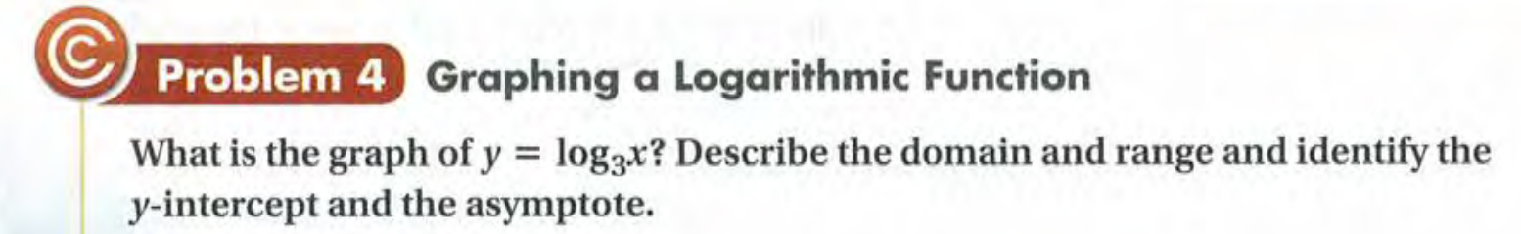

Slide 41
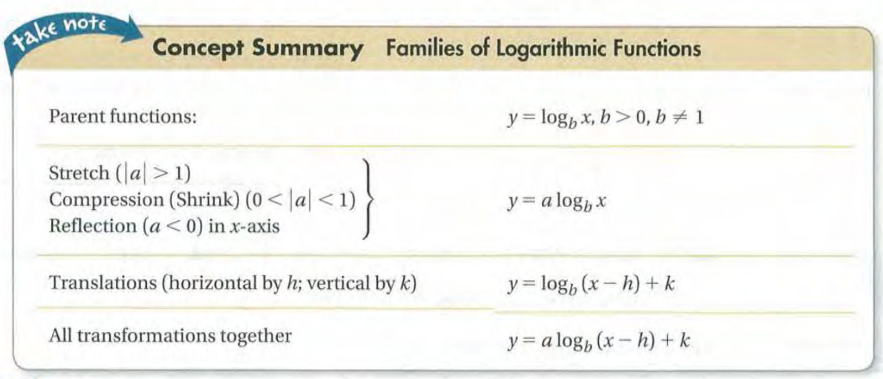
Transformation

Slide 42
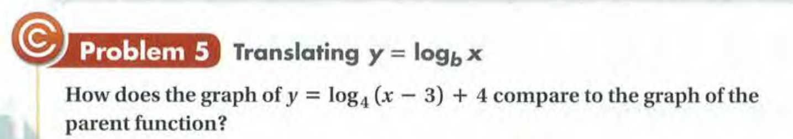

Slide 43
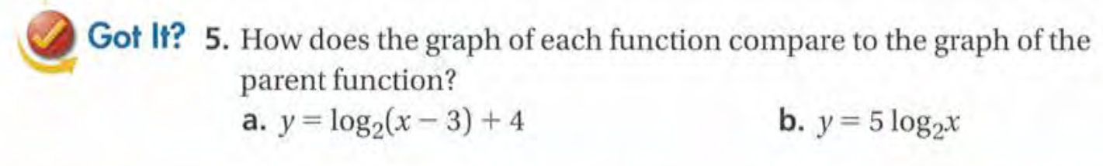

Slide 44
Exit Card: - Part 2
Complete the following on your “Logarithmic Functions as Inverses” Learning sheet!
Transformation -- pp.1
Ex#4 tp Ex#6 -- pp.3 to 4

Slide 45
Advance organizer
Learning objectives:
Understand 7.4 Properties of Logarithms
Prior knowledge:
Understand 7.3 Logarithmic Functions as Inverses
Successful criteria:
Controlled Practice: Complete the Exit Card
Freer Practice: Complete questions to your interest
Learning activities:
1. Preview and Vocabulary Check (10 minutes):
Quickly scan through the text and noting any unfamiliar terms.
2. Comprehend the Presentation (45 minutes):
3. Exit Card Completion (25 minutes):
4. Main Idea Summary and Reflection (5 minute):

Slide 46
Key terms:
Change of base formula[底数变换公式]: In mathematics, the change of base formula is a logarithmic identity that allows the conversion of logarithms from one base to another.
PH level [酸碱度水平]: PH level is a measure of the acidity or alkalinity of a solution. It is a logarithmic scale that ranges from 0 to 14, with 7 considered neutral. Values below 7 indicate acidity, while values above 7 indicate alkalinity.

Slide 47
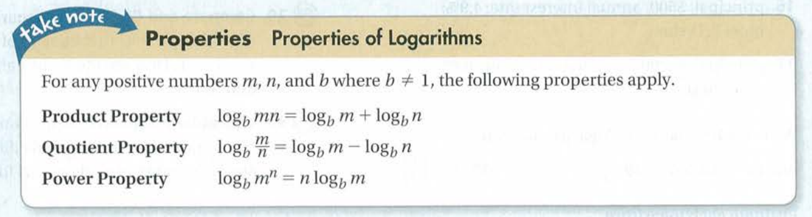

Slide 48
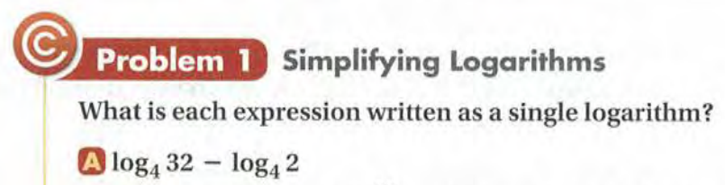
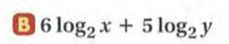

Slide 49
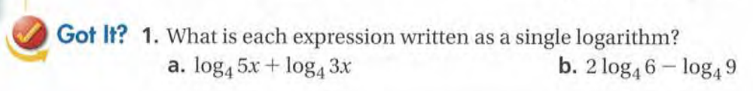

Slide 50
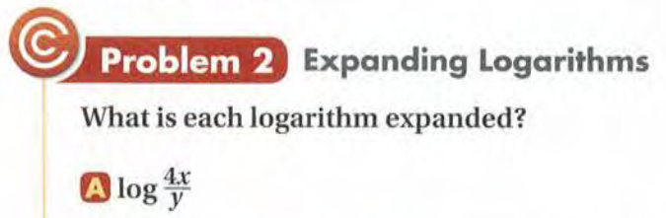
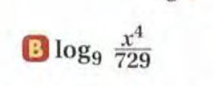

Slide 51
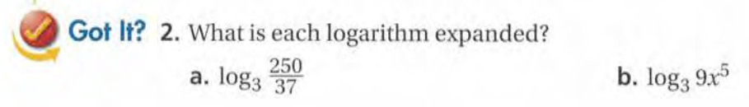

Slide 52


Slide 53
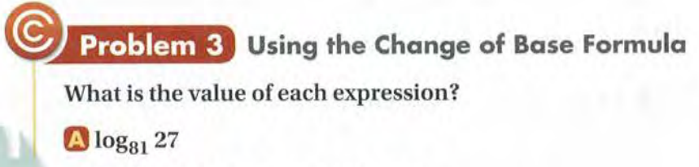
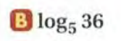

Slide 54
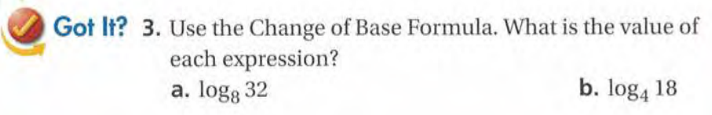

Slide 55
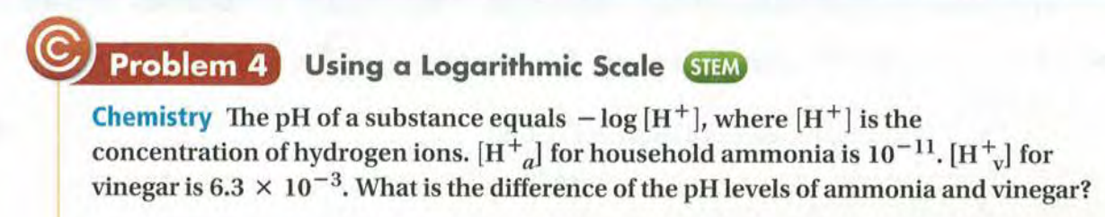
Logarithmic Scale and PH Level

Slide 56
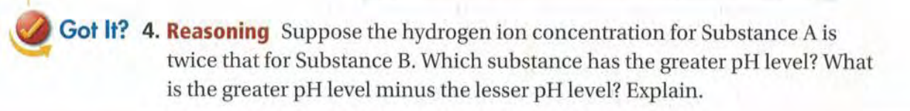

Slide 57
Exit Card:
Complete the “Properties of Logarithms” learning sheet!

Slide 58
Advance organizer
Learning objectives:
Understand 7.5 Exponential and Logarithmic Equations
Prior knowledge:
Understand 7.4 Properties of Logarithms
Successful criteria:
Controlled Practice: Complete the Exit Card
Freer Practice: Complete questions to your interest
Learning activities:
1. Preview and Vocabulary Check (10 minutes):
Quickly scan through the text and noting any unfamiliar terms.
2. Comprehend the Presentation (45 minutes):
3. Exit Card Completion (25 minutes):
4. Main Idea Summary and Reflection (5 minute):

Slide 59
Key terms:
Exponential Equation[指数方程]: An equation in which the variable appears as an exponent, often written in the form y = b^{x}
Logarithmic Equation[对数方程]: An equation that involves logarithms of variables. It can be represented in the form y = log_{b}(x)
Common base [共同底数]: In mathematics, a common base refers to a shared numerical base or radix in expressions involving exponents or logarithms.

Slide 60
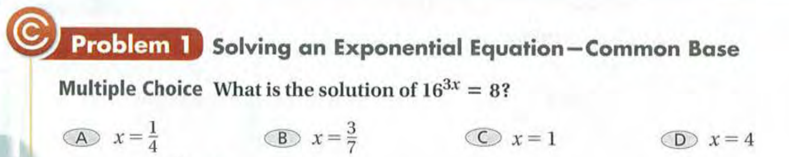

Slide 61
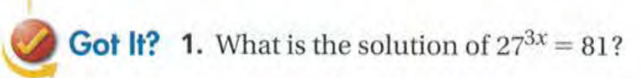

Slide 62


Slide 63
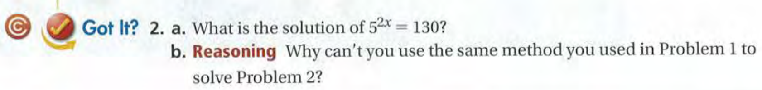

Slide 64
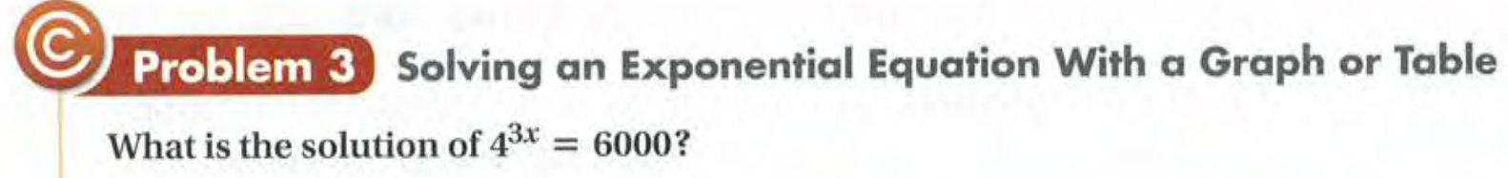

Slide 66
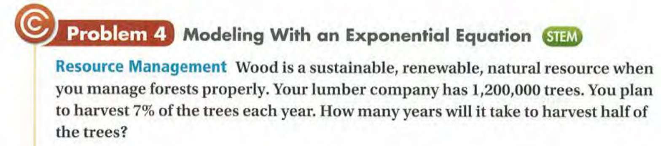

Slide 67


Slide 68


Slide 69


Slide 70


Slide 72
Exit Card:
Complete Exponential and Logarithmic Equations learning sheet!

